Slide 1
Cornerstone City Church Peninsula Plus Community Hoo Are Ya 28-05-2023

Slide 2
House Of The Lord
CCLI Song # 7168995
© 2020 Phil Wickham MusicSimply Global SongsBe Essential SongsCashagamble Jet Music
For use solely with the SongSelect® Terms of Use. All rights reserved. www.ccli.com
Note: Reproduction of this sheet music requires a CCLI Music Reproduction Licence. Please report all copies.
CCLI Licence No. 33265

Slide 3
1/5
We worship the God who was
We worship the God who is
We worship the God who evermore will be
He opened the prison doors
He parted the raging sea
My God He holds the victory yeah

Slide 4
2/5
There’s joy in the house of the Lord
There’s joy in the house of the Lord today
And we won’t be quiet
We shout out Your praise

Slide 5
3/5
There’s joy in the house of the Lord
Our God is surely in this place
And we won’t be quiet
We shout out Your praise

Slide 6
4/5
We sing to the God who heals
We sing to the God who saves
We sing to the God who always makes a way
'Cause He hung up on that cross
Then He rose up from that grave
My God’s still rolling stones away

Slide 7
5/5
We were the beggars
Now we’re royalty
We were the prisoners
Now we’re running free
We are forgiven accepted
Redeemed by His grace
Let the house of the Lord sing praise

Slide 8
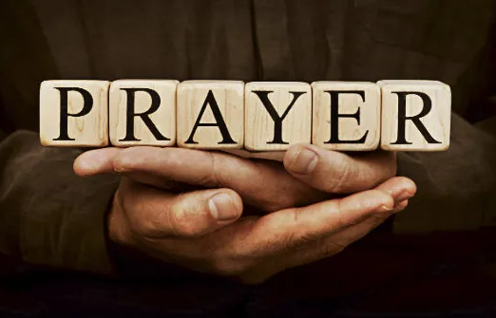

Slide 9


Slide 10
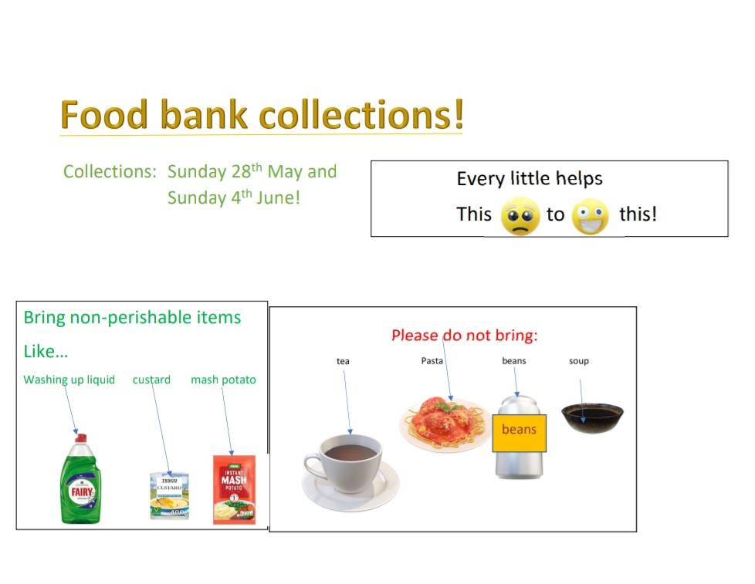

Slide 11


Slide 12
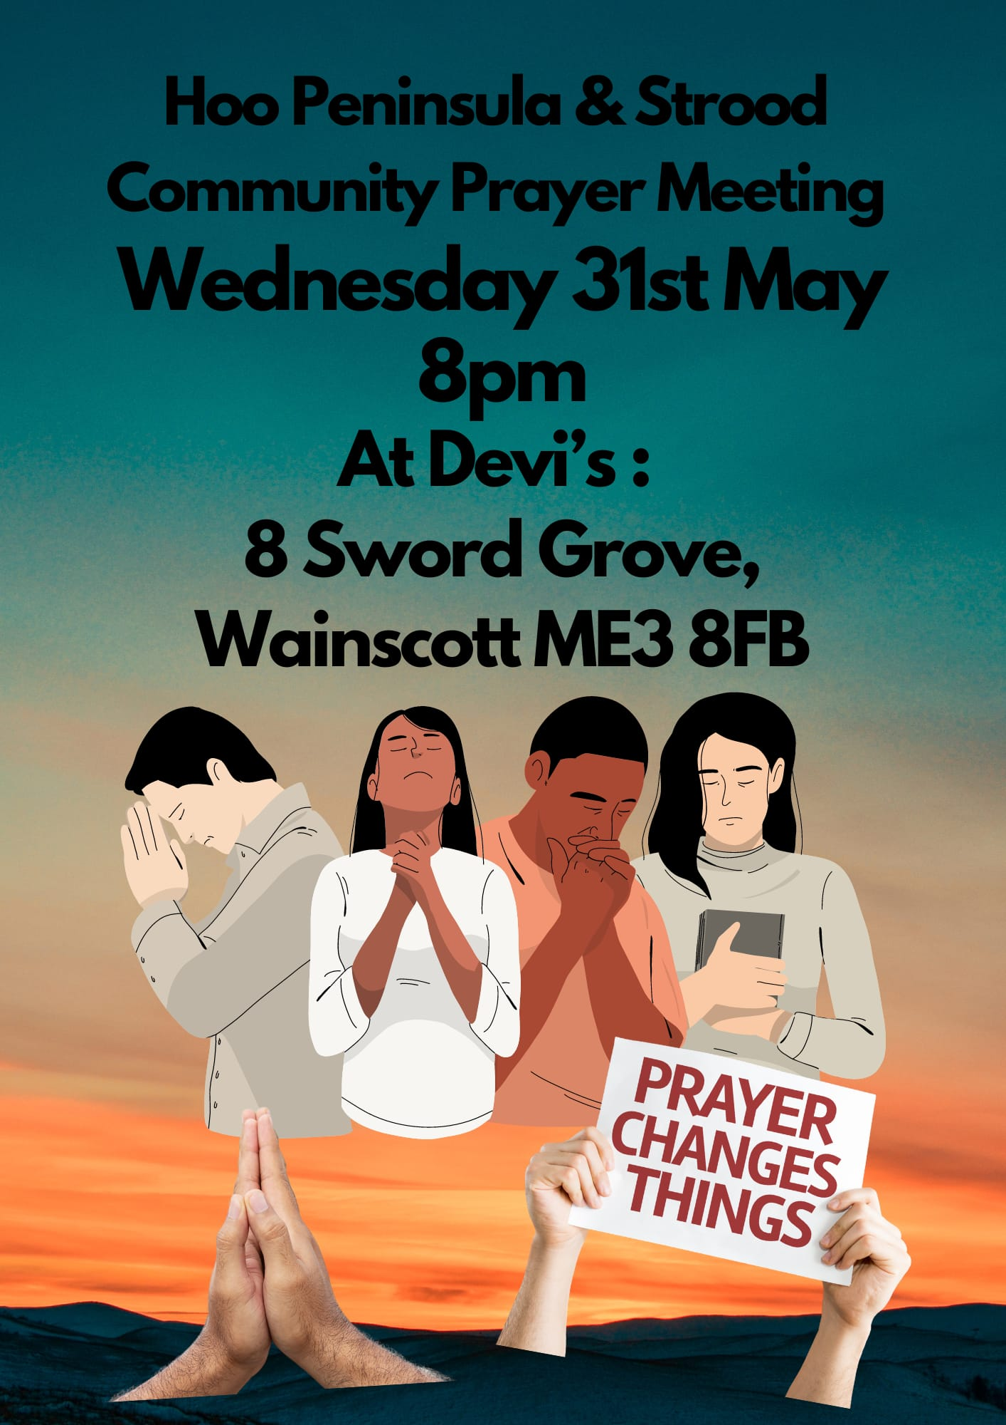

Slide 13


Slide 14


Slide 16
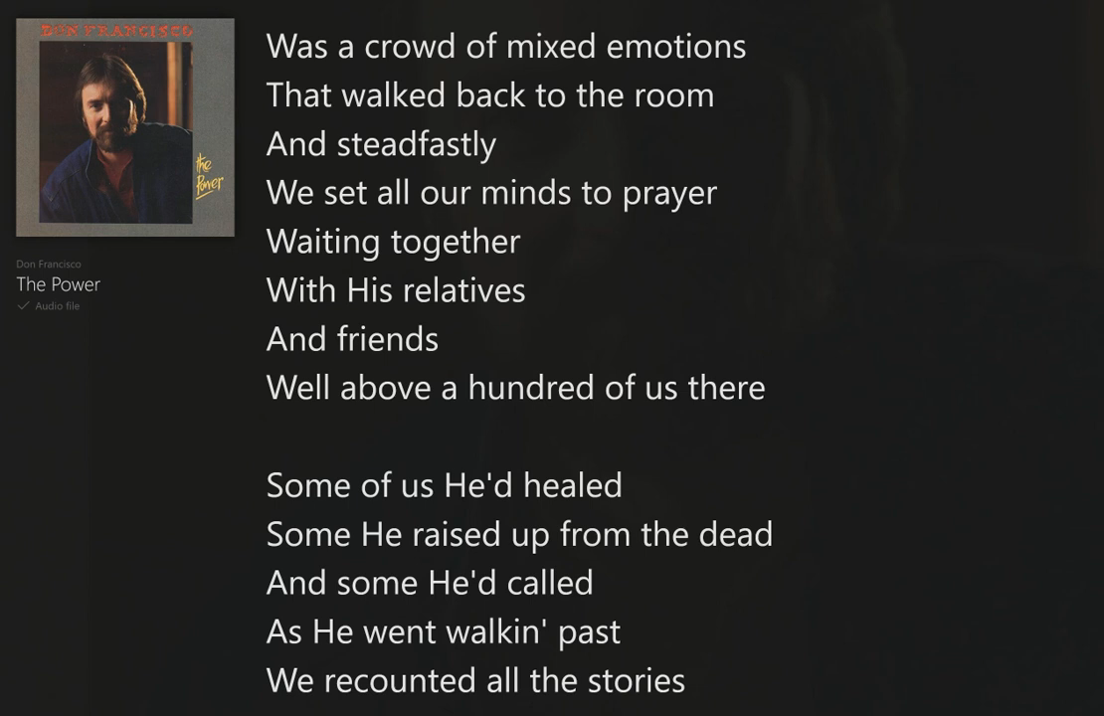

Slide 18
Holy Spirit We Welcome You
CCLI Song # 215942
Chris Bowater
© 1986 Sovereign Lifestyle Music
For use solely with the SongSelect® Terms of Use. All rights reserved. www.ccli.com
CCLI Licence No. 33265

Slide 19
1/3
Holy Spirit we welcome You
Holy Spirit we welcome You
Move among us with holy fire
As we lay aside all earthly desire
Hands reach out and our hearts aspire
Holy Spirit Holy Spirit
Holy Spirit we welcome You

Slide 20
2/3
Holy Spirit we welcome You
Holy Spirit we welcome You
Let the breeze of Your presence blow
That Your children here might truly know
How to move in the Spirit's flow
Holy Spirit Holy Spirit
Holy Spirit we welcome You

Slide 21
3/3
Holy Spirit we welcome You
Holy Spirit we welcome You
Please accomplish in us today
Some new work of loving grace we pray
Unreservedly have Your way
Holy Spirit Holy Spirit
Holy Spirit we welcome You

Slide 22
Holy Spirit
CCLI Song # 6087919
Bryan Torwalt | Katie Torwalt
© 2011 Capitol CMG Genesis (Admin. by Capitol CMG Publishing)
Jesus Culture Music (Admin. by Capitol CMG Publishing)
For use solely with the SongSelect® Terms of Use. All rights reserved. www.ccli.com
CCLI Licence No. 3326

Slide 23
1/5
There's nothing worth more that will ever come close
No thing can compare You're our living hope
Your Presence

Slide 24
2/5
I've tasted and seen of the sweetest of loves
Where my heart becomes free and my shame is undone
In Your Presence Lord

Slide 25
3/5
Holy Spirit You are welcome here
Come flood this place and fill the atmosphere
Your glory God is what our hearts long for
To be overcome by Your Presence Lord

Slide 26
4/5
Let us become more aware of Your Presence
Let us experience the glory of Your goodness (Lord)

Slide 27
5/5
There's nothing worth more that will ever come close
No thing can compare You're our living hope
Your Presence

Slide 29
Spirit Break Out
CCLI Song # 6058450
Ben Bryant | Luke Hellebronth | Myles Dhillon | Tim Hughes
© 2010 Thankyou Music (Admin. by Integrity Music)
For use solely with the SongSelect® Terms of Use. All rights reserved. www.ccli.com
CCLI Licence No. 33265

Slide 30
1/4
Our Father all of heaven roars Your name Sing louder let this place erupt with praise Can you hear it the sound of heaven touching earth The sound of heaven touching earth

Slide 31
2/4
Spirit break out Break our walls down Spirit break out Heaven come down

Slide 32
3/4
King Jesus You're the name we're lifting high Your glory shaking up the earth and skies Revival we want to see Your kingdom here We want to see Your kingdom here

Slide 33
4/4
Spirit break out Break our walls down Spirit break out Heaven come down

Slide 35
Spirit Of The Living God CCLI Song # 23488
Daniel Iverson
© Words: 1935. Renewed 1963 Birdwing Music (Admin. by Capitol CMG Publishing)
Music: 1935. Renewed 1963 Birdwing Music (Admin. by Capitol CMG Publishing)
For use solely with the SongSelect® Terms of Use. All rights reserved. www.ccli.com
CCLI Licence No. 33265

Slide 36
1/2
Spirit of the living God
Fall afresh on me
Spirit of the living God
Fall afresh on me

Slide 37
2/2
Melt me mould me
Fill me use me
Spirit of the living God
Fall afresh on me

Slide 39
Way Maker CCLI Song # 7115744
Osinachi Kalu Okoro Egbu
© 2016 Integrity Music Europe (Admin. by Integrity Music)
For use solely with the SongSelect® Terms of Use. All rights reserved. www.ccli.com
CCLI Licence No. 33265

Slide 40
1/4
You are here moving in our midst I worship You I worship You You are here working in this place I worship You I worship You
(You are) Way Maker Miracle Worker Promise Keeper Light in the darkness my God that is who You are

Slide 41
2/4
You are here touching ev'ry heart I worship You I worship You You are here healing ev'ry heart I worship You I worship You
(You are) Way Maker Miracle Worker Promise Keeper Light in the darkness my God that is who You are

Slide 42
You are here turning lives around I worship You I worship You You are here mending ev'ry heart I worship You yeah I worship You Lord
(You are) Way Maker Miracle Worker Promise Keeper Light in the darkness my God that is who You are
3/4

Slide 43
That is who You are x4
Even when I don't see it You're working Even when I don't feel it You're working You never stop You never stop working x2
4/4

